Slide 1
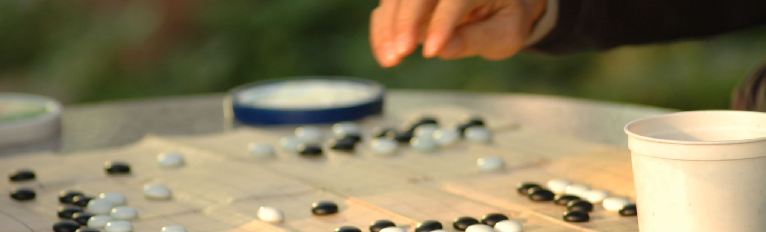
Guessing Number Game
Team Members
2010030054 – SAI SHANKAR
2010030122 – YESHWANTH
2010030325 – SAI MANASWI
2010030474 – SRIKAR

Slide 2

Table of contents
Abstract
Introduction
Improvements of Guessing Game
Objectives
Tools
results
Conclusion

Slide 3
Abstract
Two entities are playing a simple game. One is computer set a number, and the player tries to guess at the number repeatedly.
The game will end after 10 attempts and if the player failed to guess the number, and then player loses the game.

Slide 4
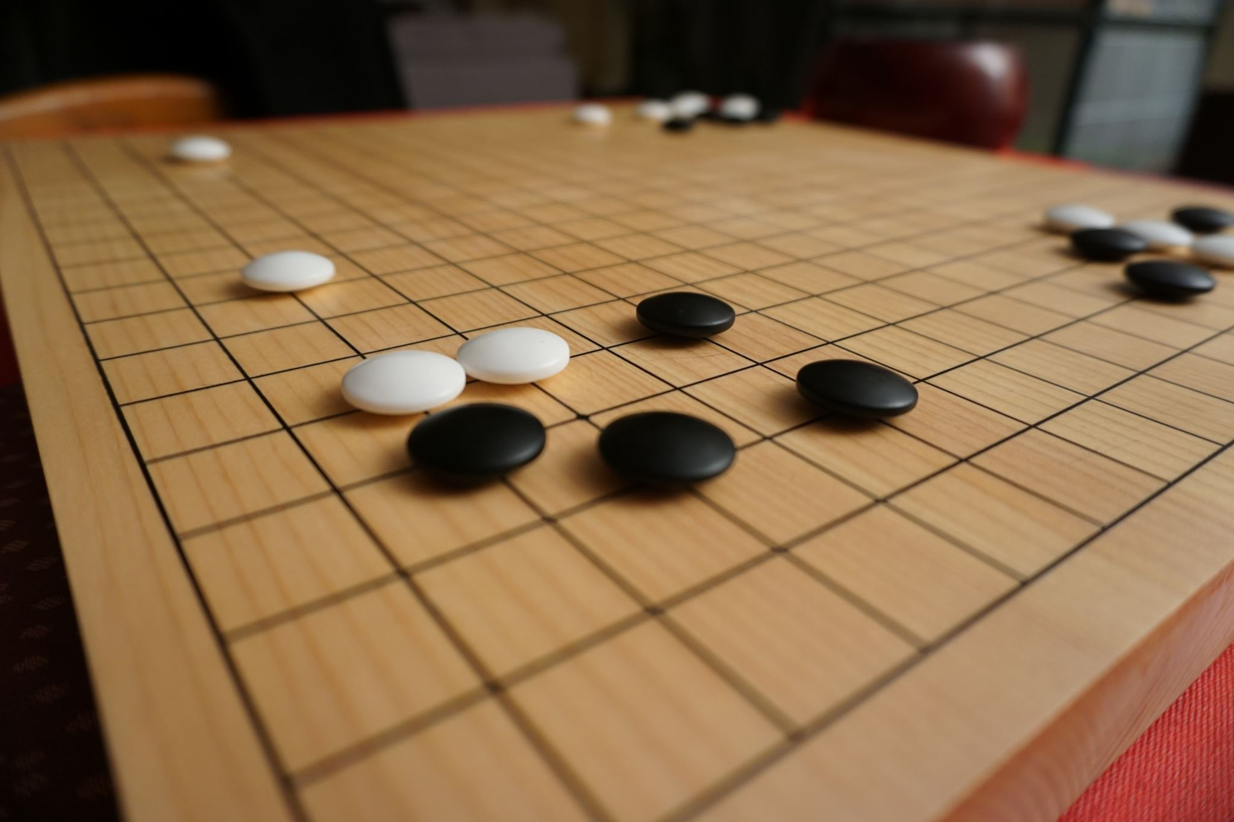
Introduction
In this game, the program generates random number but this number is not visible to the player.
This Project is an interactive guessing game, which will ask the user to guess a number set by computer.
Player tries to guess the number. If the player enters the same number that is generated by system then program displays the winning message and game ends there.
If the player enters wrong number then that number is evaluated. If the number is greater than right answer than system gives a hint that entered number is ‘high’ otherwise if number is smaller than right answer than it says ‘lower’.
There are limited number of attempts available with the user to win the game.

Slide 5
Improvements of Guessing Game
Improvement number 1
we could make it more complex by getting the computer to count the guesses until the person guesses the right number
Improvement number 2
we could have included a loop in my guessing game so that it worked better and was more complex.
5

Slide 6
Objectives
Create a guessing game that told you if the number you put in was too high or too low and then congratulated you when the number was correct.
To make sure your guessing game was correctly working through the whole thing.
Guessing game was to create a flowchart that you would enter your guess in and it would tell you if you’re answer should be higher, lower or if it’s spot on. We had to include variables, inputs and outputs.
Tools
Predefined modules
Random package
Frame Work
Django,Flask
Software
Pycharm, visual studio
6

Slide 7
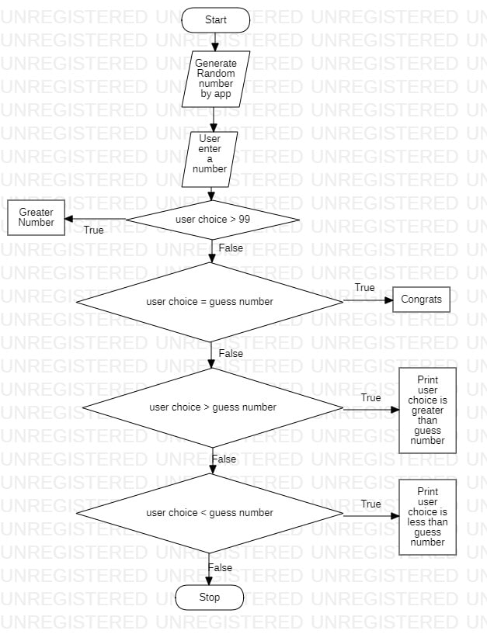
Flow chart

Slide 8
Implementation
Import the libraries
from flask import Flask from random import randint

Slide 9
from flask import Flask from random import randint correct_number = randint(0, 9) app = Flask(__name__) def make_bold(function): def wrap(): data = function() return f"<b>{data}</b>" return wrap @app.route('/') @make_bold def guess_a_number(): return "<h1>Hey, guess a number between 0 and 9!</h1>" \ "<p>Write after the '5000/' URL</p>" \ "<img src='https://media.giphy.com/media/3o7aCSPqXE5C6T8tBC/giphy.gif'>" @app.route('/<int:user_choice>') def is_correct(user_choice): if user_choice > 9: return f"<h1>HEY, WHO ARE YOU TRYING TO CHEAT????? 🧐</h1>" \ "<img src='https://media.giphy.com/media/VbnUQpnihPSIgIXuZv/giphy.gif'>" elif user_choice == correct_number: return f"<h1>Oh no. You found me 🤭</h1>" \ "<img src='https://media.giphy.com/media/ICOgUNjpvO0PC/giphy.gif'>" elif user_choice < correct_number: return f"<h1>That's too low 😋</h1>" \ "<img src='https://media.giphy.com/media/l4KibK3JwaVo0CjDO/giphy.gif'>" elif user_choice > correct_number: return f"<h1>Wow... That's too high 🤪</h1>" \ "<img src='https://media.giphy.com/media/S6VGjvmFRu5Qk/giphy.gif'>" if __name__ == "__main__": app.run()

Slide 10
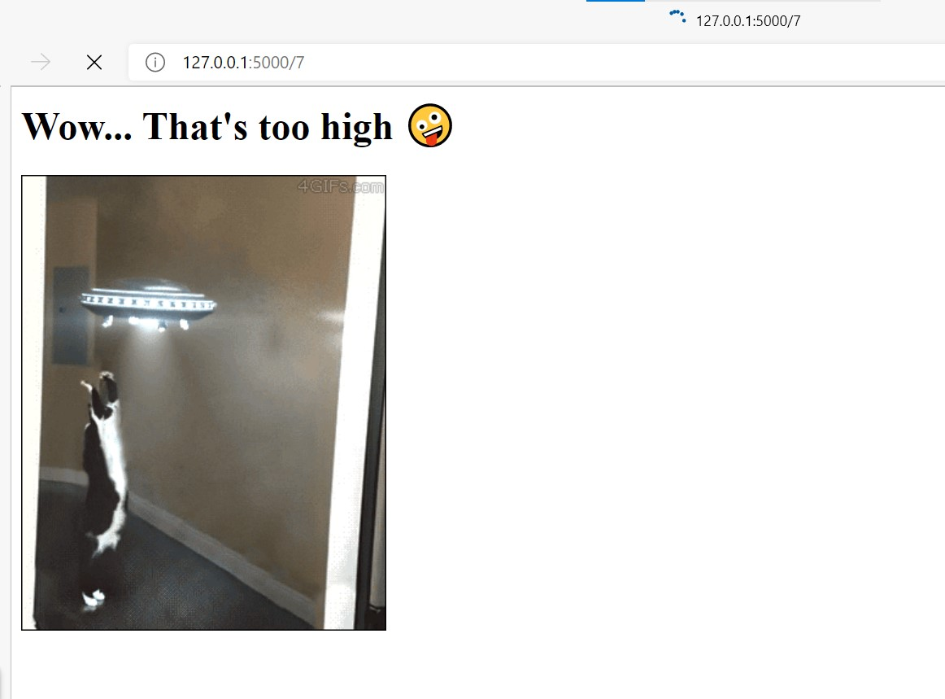
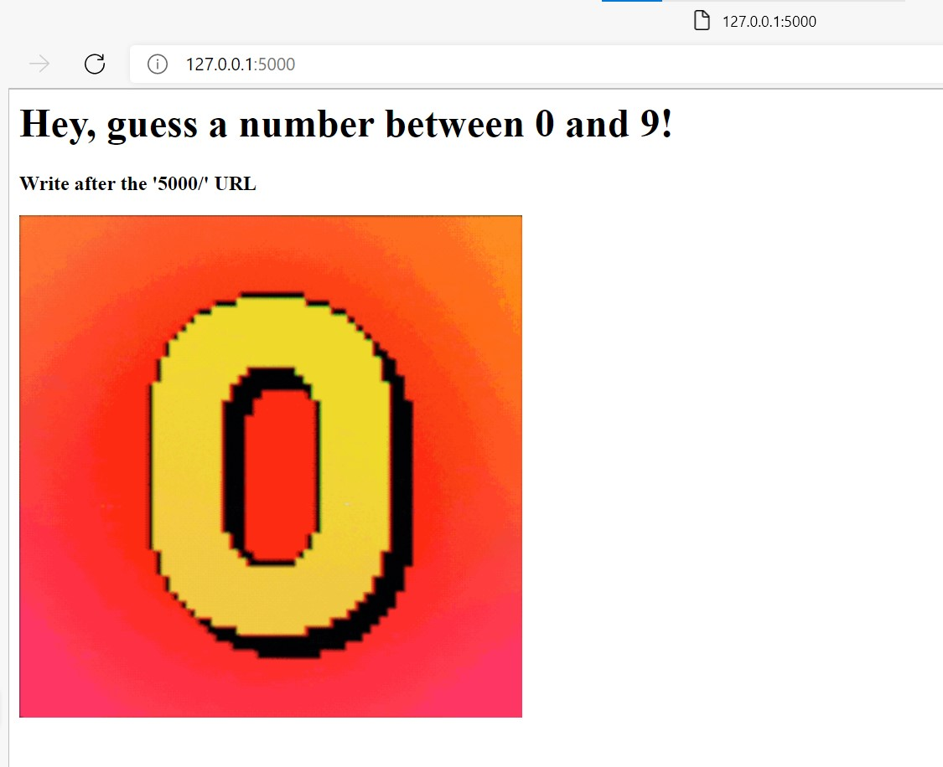
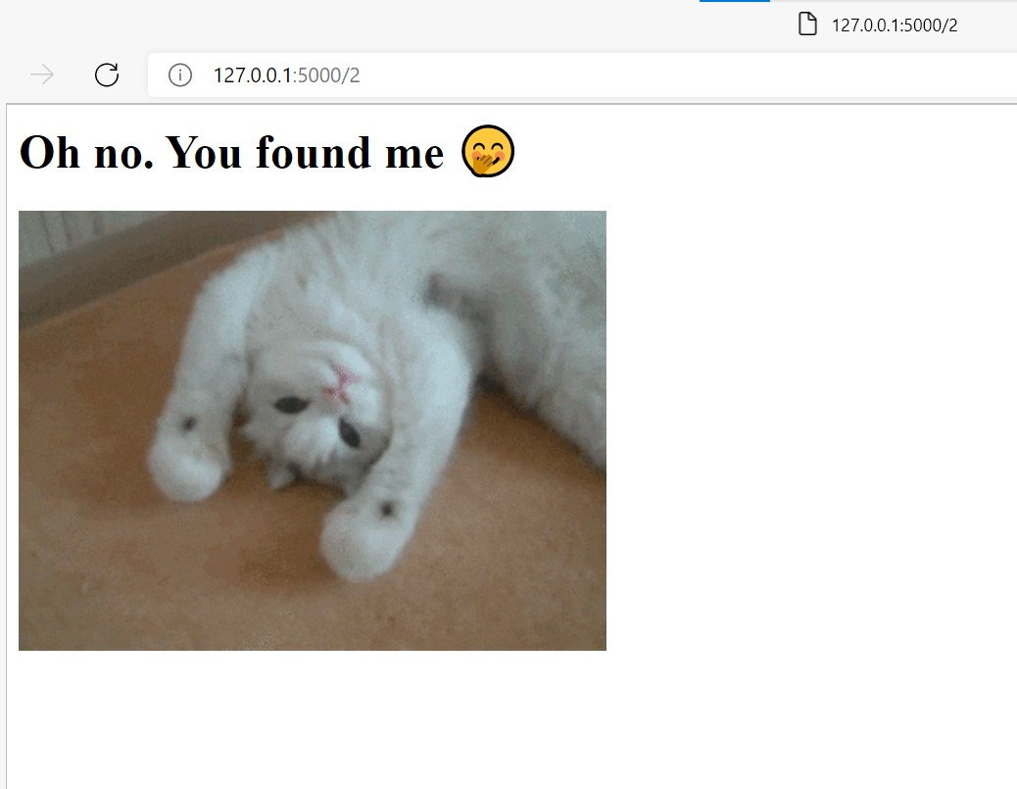
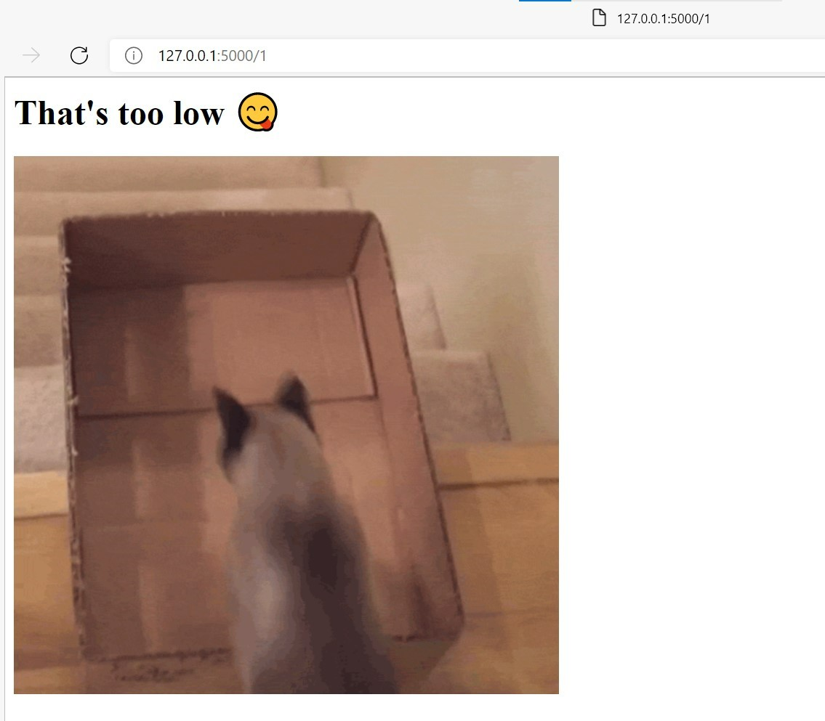
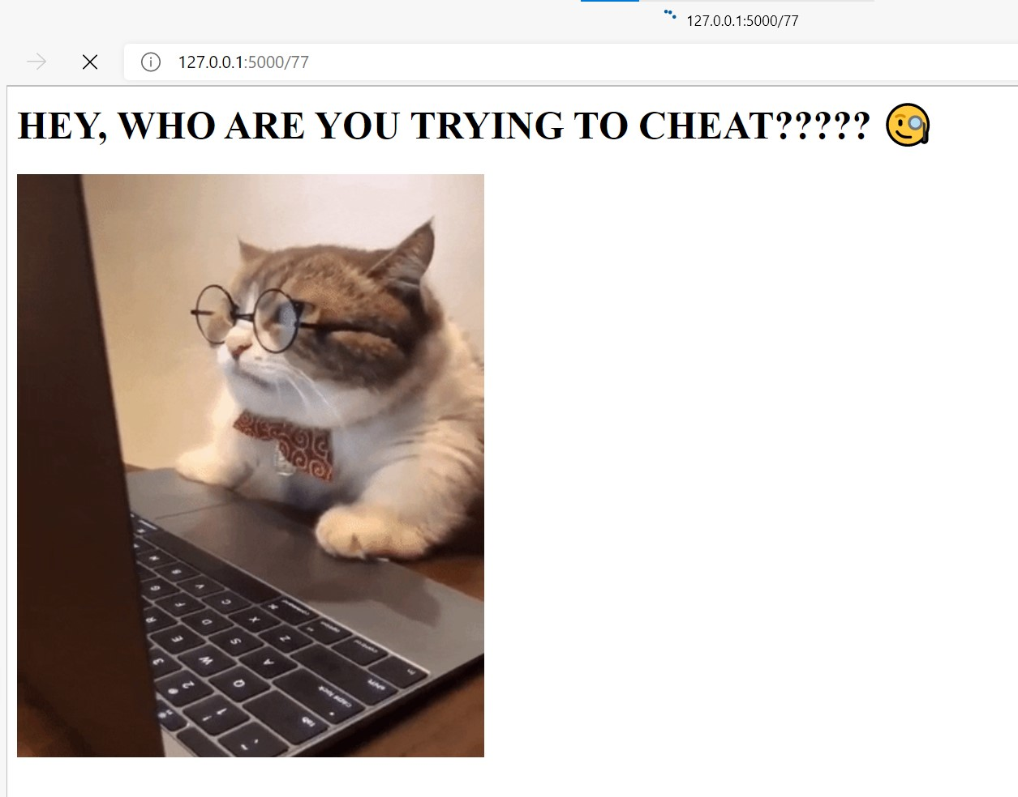
Alpha testing

Slide 11

RESULTS
In our Python number guessing game we will use for loop to limit the number of attempts by the player.
We will provide 5 chances to guess the right answer after that game will be over and player will loose.
11

Slide 12
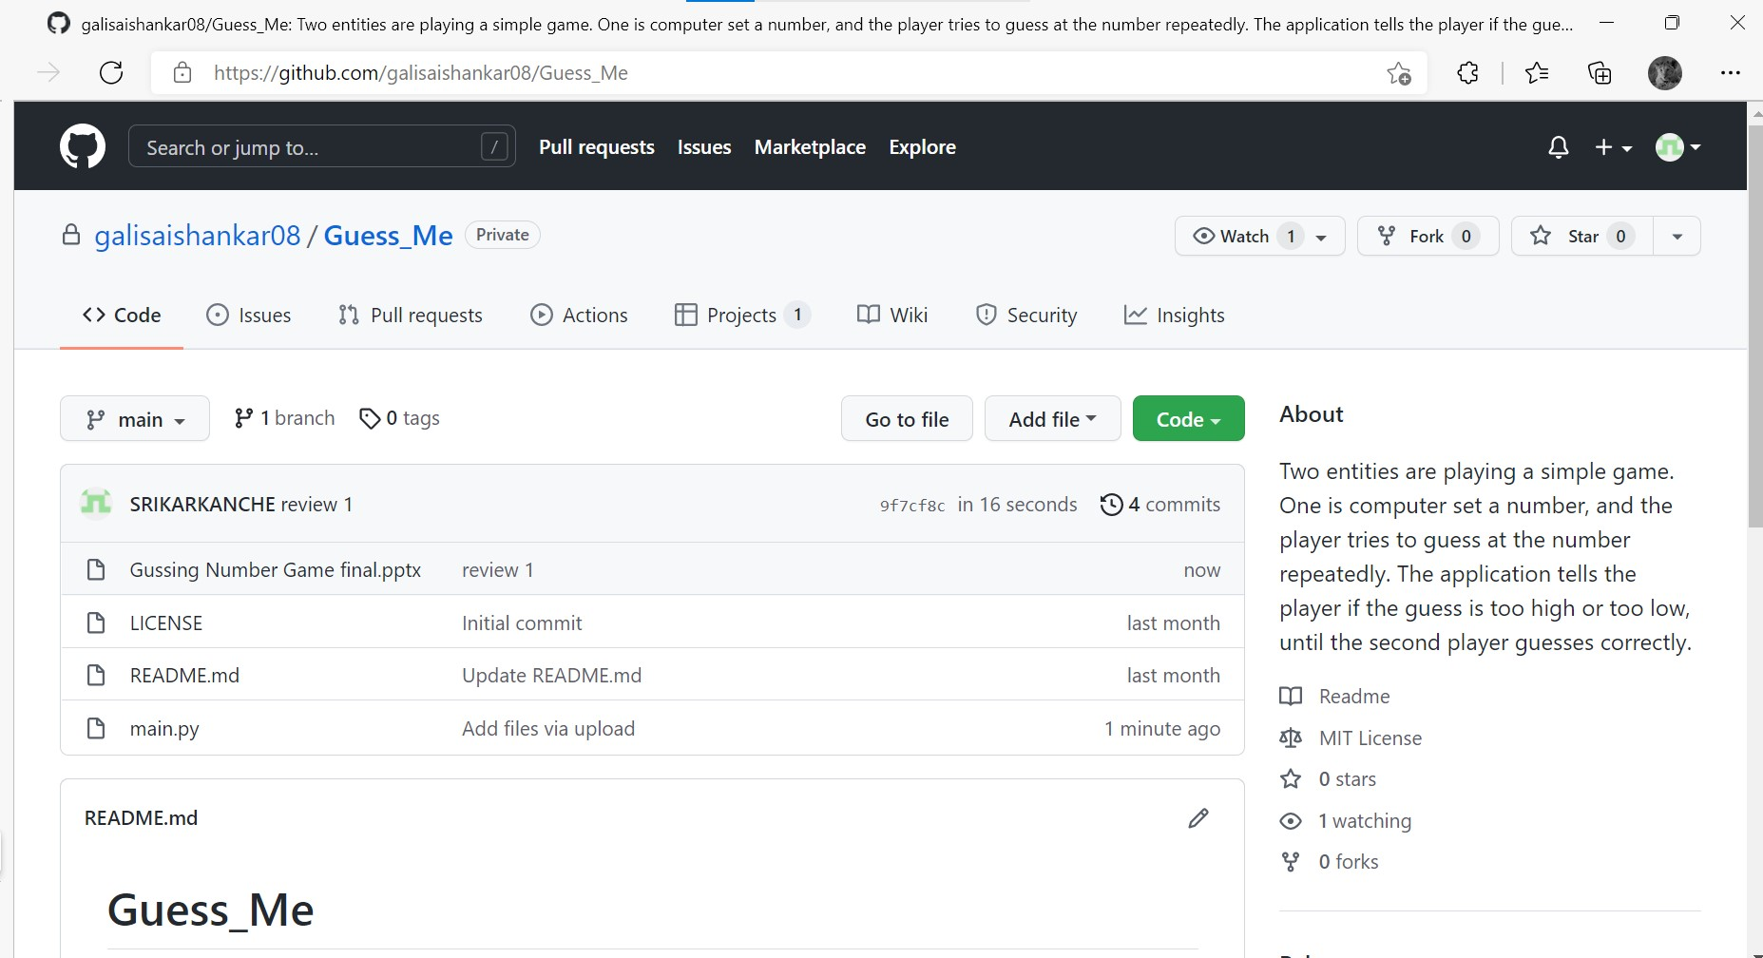
Github setup

Slide 13
Conclusion
Finally our application will have a interactive user interface, analytics of each user and difficultly levels.
13

Slide 14

Thank you

